Slide 1
Prison Pain Management Formulary Implementation Doctor George Ryan george.ryan@phe.gov.uk

Slide 2
Number of patients prescribed opioids
Most [opioid] drugs don’t work for most patients-British Medical Journal June and August 2013

Slide 3
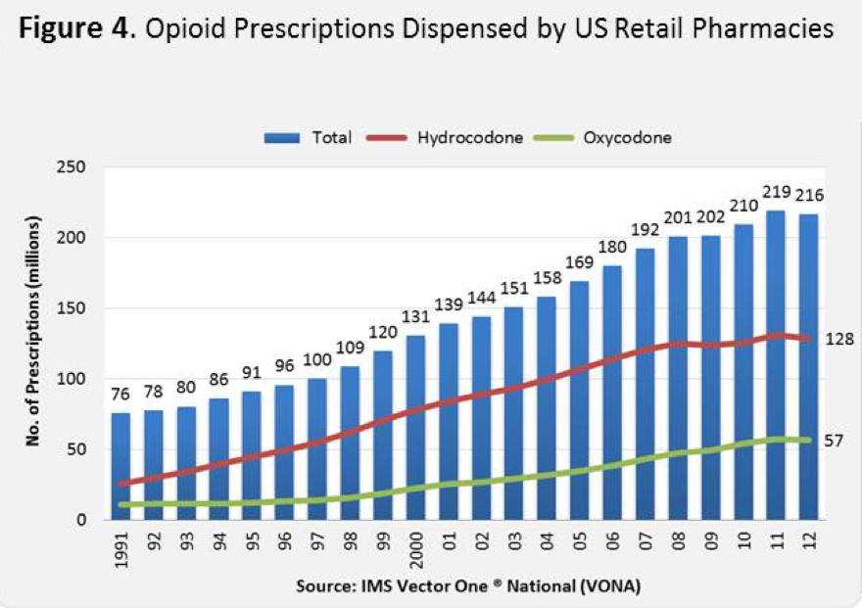
http://www.drugabuse.gov/about-nida/legislative-activities/testimony-to-congress/2014/harnessing-power-science-to-inform-substance-abuse-addiction-policy-practice

Slide 4
What’s the problem?
Perceptions of pain-wide variations in prevalence of chronic pain
Responses to pain-wide variations in prescribing
Patients-unhelpful self selection
Prescribers-locums in prisons, unsupported GPs, and some pain specialists
Pharmaceutical companies-skilful marketing and promotion
Pharmacy chains-skilful marketing and displays

Slide 5
Illicit medication use in current prison, by type of medication (excluding OTC medication)* Total greater than 100% as some prisoners taking more than one drug
Source-Thematic report by HM Inspectorate of Prisons: Changing patterns of substance misuse in adult prisons and service responses December 2015

Slide 6
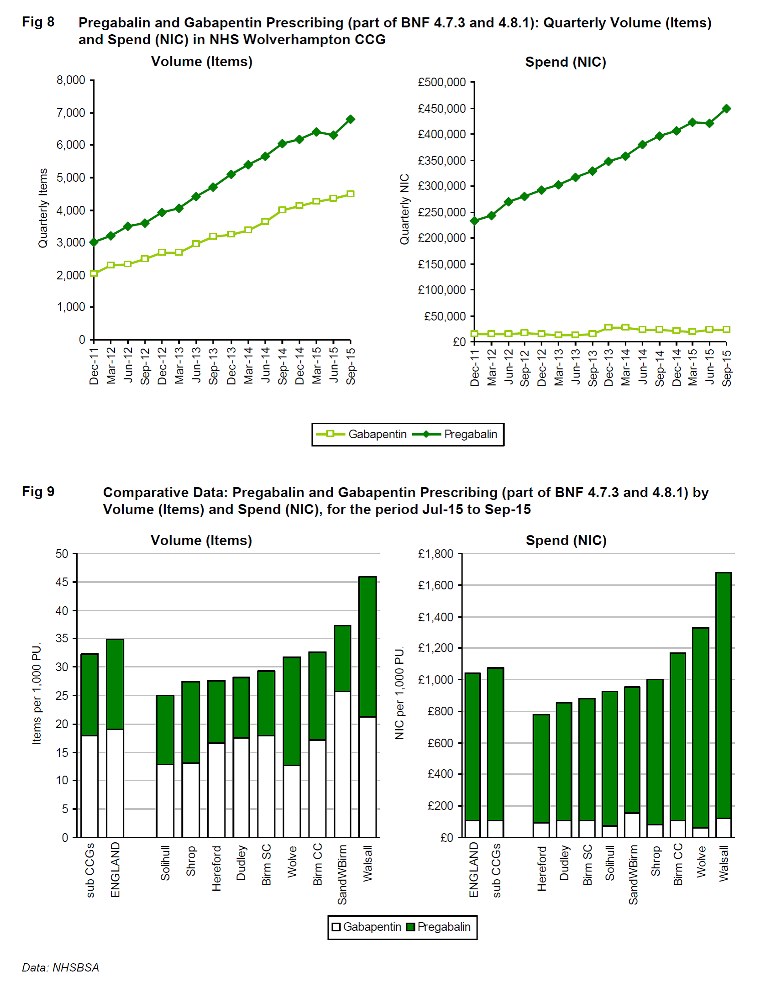

Slide 7
HMP prescribing rates for pregabalin/gabapentin twice that of community
Over half of prisoners prescribed gabapentin and pregabalin have a history of substance misuse
47% taking on opiate substitute treatment [methadone, buprenorphine or suboxone]
49% taking opioid analgesic—5% of these taking more than one opioid
35% co-prescribed an opioid are taking tramadol
Source-The prescribing and management of Gabapentin and Pregabalin in HM Prisons and Immigration Removal Centres in England May 2013

Slide 8
Regional variations-3.71% in East 1.59% in London
Establishment variations-0% in IRCs 1.26% YOI 3.73% Trainer Prisons
16.1% with no documented indication for prescribing of pregabalin, gabapentin
22% taking for unlicensed indications (migraine, low back pain, sciatica, arthritis)
82% taking pregabalin or gabapentin had medication review within 6 months
Source-The prescribing and management of Gabapentin and Pregabalin in HM Prisons and Immigration Removal Centres in England May 2013

Slide 9
Pain and suffering
Impairment
Poor mobility
Depression
Irritability
Isolation
Rumination
Impact on partner, family, carers
Redundancy, divorce, family break up

